Slide 1
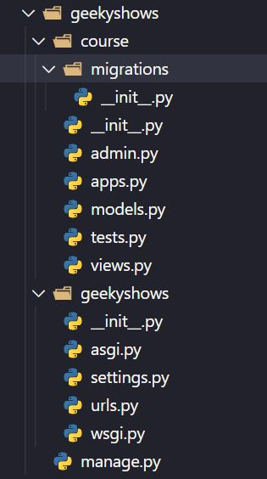
Application Directory Structure
Go to Project Folder
Run Command python manage.py startapp course
course
migrations
__init__.py
__init__.py
admin.py
apps.py
models.py
tests.py
views.py

Slide 2
Application Directory Structure
migrations – This folder contains __init__.py file which means it’s a python package. It also contains all files which are created after running makemigration command .
__init__.py – The folder which contains __init__.py file is considered as Python Package.
admin.py – This file is used to register sql tables so we could perform CRUD operation from Admin Application. Admin Application is provided by Django to perform CRUD operation.
apps.py – This file is used to config app.
models.py – This file is used to create our own model class later these classes will be converted into database table by Django for our application.
tests.py – This is files is used to create tests.
views.py – This file is used to create view. We write all the business logic related code in this file.

